Slide 1
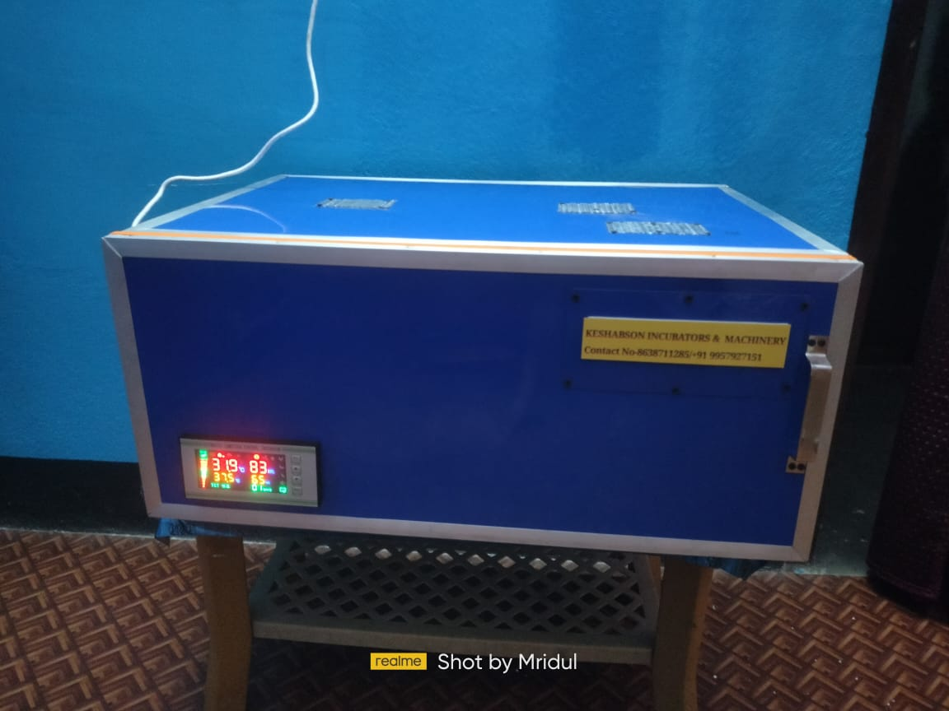
Insert Company Logo
Agriculture & Allied
Project Proposal : DEVELOPEMENT OF A FULLY AUTOMATIC EGG INCUBATOR FOR RURAL FARMERS IN INDIA
APPLICATION
Animal Husbandry
COMPANY NAME
TECHNOLOGY READINESS LEVEL (TRL)
INTELLECTUAL PROPERTY
Type your company name
TRL: 2/3
NA
FOUNDER’S NAME (Individual Innovator)
Type Founder(s) Name : MRIDUL KUMAR
PROBLEM ADDRESSED
PRODUCT IMAGE
Power consumption should be lowered,
Cost reduction is needed
Standardization is needed
Machinery equipments & Power back
needed to manufacture the Egg Incubator,
Technical Guidance needed
Don't Have the permanent team
ABOUT THE TECHNOLOGY
Egg incubator is a machine that hatch the
eggs of chicken, ducks or other
poultry birds artificially without the mother
hen or duck. In the machine temperature, humidity and egg rotations are controlled automatically.
END USERS / CUSTOMERS
USP
Poultry Farmers
SHG Women
Unemployed youths
Affordable price with Humidity Control system,
More than 6 hours no impact on eggs if power cuts.
Providing Inbuilt egg Candler for fertility check in eggs.
One stop Platform for Poultry farmers (Eggs & Chicks, ducklings linkages for Users)
ROI in 4 Months.
FUNDS RAISED/ACHIEVEMENTS
NA
Incubated at KIIT-TBI
CompanY Website link
tbi@kiitincubator.in

