Slide 1
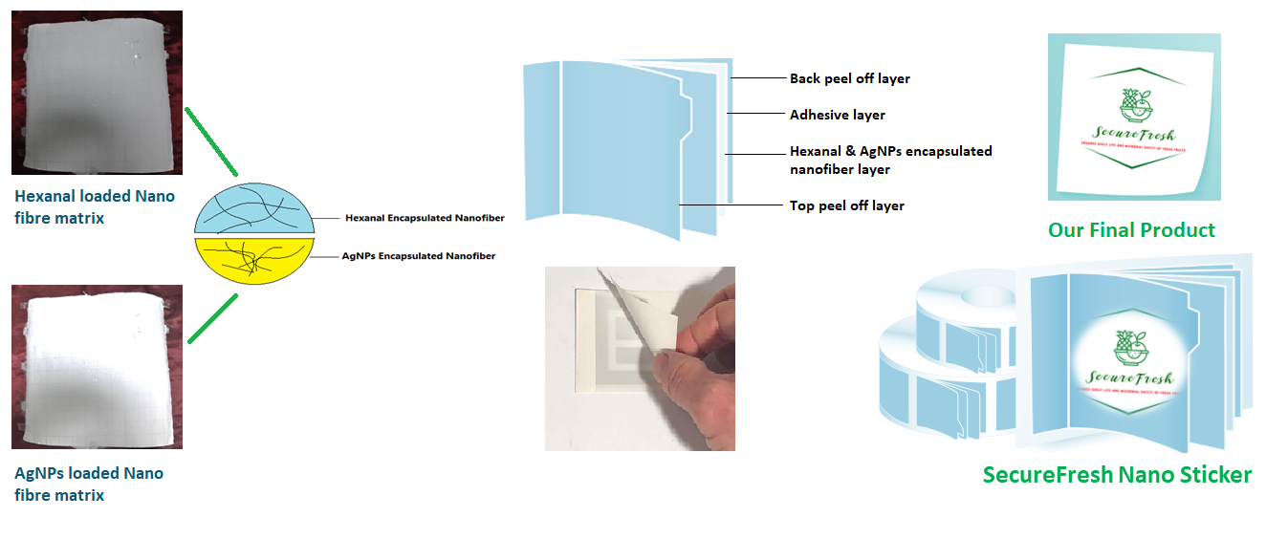
Food Technology
Development of Nanofiber-Based Stickers for Extending Shelf Life and Enhancing Microbial Safety of Fresh Fruits
APPLICATION
Our SecureFresh Nanofiber Sticker offers extended windows for marketing fresh fruit and facilitates the global trade
Delay ripening and reduce microbial spoilage to extend the shelf life and to enhance the microbial safety of fresh produces
COMPANY NAME
TECHNOLOGY READINESS LEVEL (TRL)
INTELLECTUAL PROPERTY
Kìmum Packaging Solutions
TRL: 2
Nil
FOUNDER’S NAME
Arun Prasath V
Aarthy Viswanath
PROBLEM ADDRESSED
PRODUCT IMAGE
India lost about 15–30% of its fruits and vegetables. If we were to give it a number, it's a problem worth over ₹1,52,000 crores!
There is no low cost preservation techniques available to adapt at packaging and distribution phase
ABOUT THE TECHNOLOGY
Nanofiber-Based Stickers for Extending Shelf Life and Enhancing Microbial Safety of Fresh Fruits.
Unique approach using electrostatic forces to produce nano-fibre based stickers for extending shelf life and enhancing microbial safety of fresh fruits.
Using smart controlled release of Hexanal and Silver Nanoparticles
USP
Innovative low cost preservation techniques
Extended shelf life (60%)
Reduced microbial spoilage (40%)
Higher nutrient retention (20%)
Improved food security
Minimized food waste
Increased export revenue
END USERS / CUSTOMERS
FUNDS RAISED/ACHIEVEMENTS
Food processing industries
Exporters
Fresh fruits retailers
Hypermarket,
Stakeholders and distributors
Nil
Incubated at KIIT-TBI
CompanY Website link
tbi@kiitincubator.in

