Slide 1
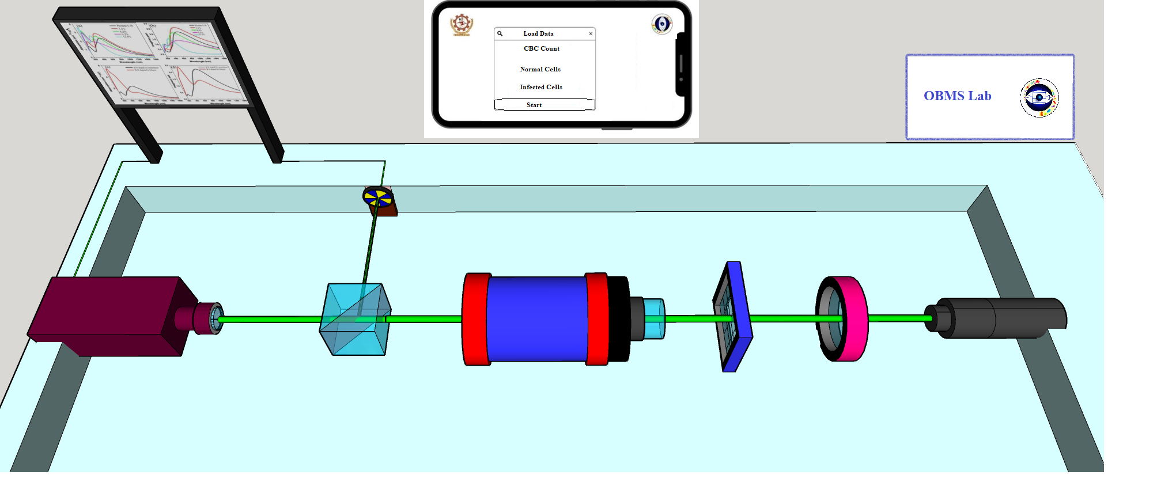
Insert Company Logo
Technology
Development of Indigenous Point-of-Care Single-cell High Throughput Absorption Flow-Cytometer for Screening of Malaria and Dengue
APPLICATION
Biomedical Applications, Point-of-care screening. Blood cells classifications
COMPANY NAME
TECHNOLOGY READINESS LEVEL (TRL)
INTELLECTUAL PROPERTY
Type your company name
TRL:2
Give Patent details (App No, Title, Status)
FOUNDER’S NAME
Dr. Earu Banoth, Dr. Bala Chakravarthy N, Dr. Puneet K. J. and Dr. Prasoon Kumar
PROBLEM ADDRESSED
PRODUCT IMAGE
According to the latest WHO report, over 249 million cases of malaria in 2022 and 244 million cases in 2021. The estimated deaths stood at 608000 in 2022 and 610000 in 2021. The present practice is clinical microscopy and RDT. Lack of label-free, quantitative POC device for Malaria Screening and diagnosis in resources limited setting. This problem is still exists. We would be working on developing PoC to address the remote location problems.
AI-enabled GUI
TII
Detector and Microcontroller
Focusing Lens
Camera
BS
Objective
Microfluidic
device
Source
The final prototype is similar to the Screening/detection of malaria at POC. The smart prototype would be integrated with Optics, a microfluidic device, simple electronics, and an integrated GUI display for screening applications.
ABOUT THE TECHNOLOGY
Absorption Flowcytometry, Development of compact, battery-operated, handheld point-of-care malaria detection/ screening device for field testing and validation.
USP
Cost-effective,
rapid,
portable POC device for accurate detection of malaria
FUNDS RAISED/ACHIEVEMENTS
END USERS / CUSTOMERS
1. Nil
2. BIRAC-BIG is our primary fund raised project.
3. Other Technical projects have been received from SERB. (Not applicable)
Primary health care centers,
Healthcare NGO’s,
Private Clinics & Hospitals
Incubated at KIIT-TBI/ FTBI, NIT Rourkela
CompanY Website link: Under progress
tbi@kiitincubator.in

