Slide 1
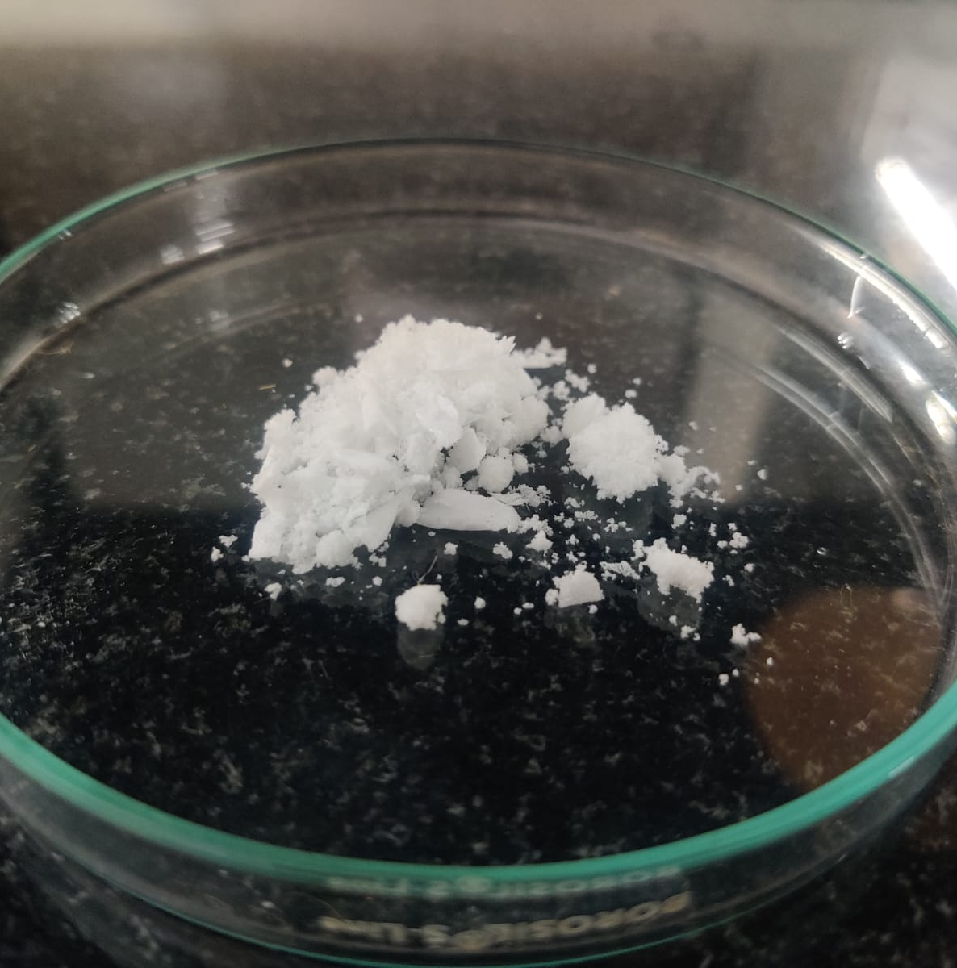
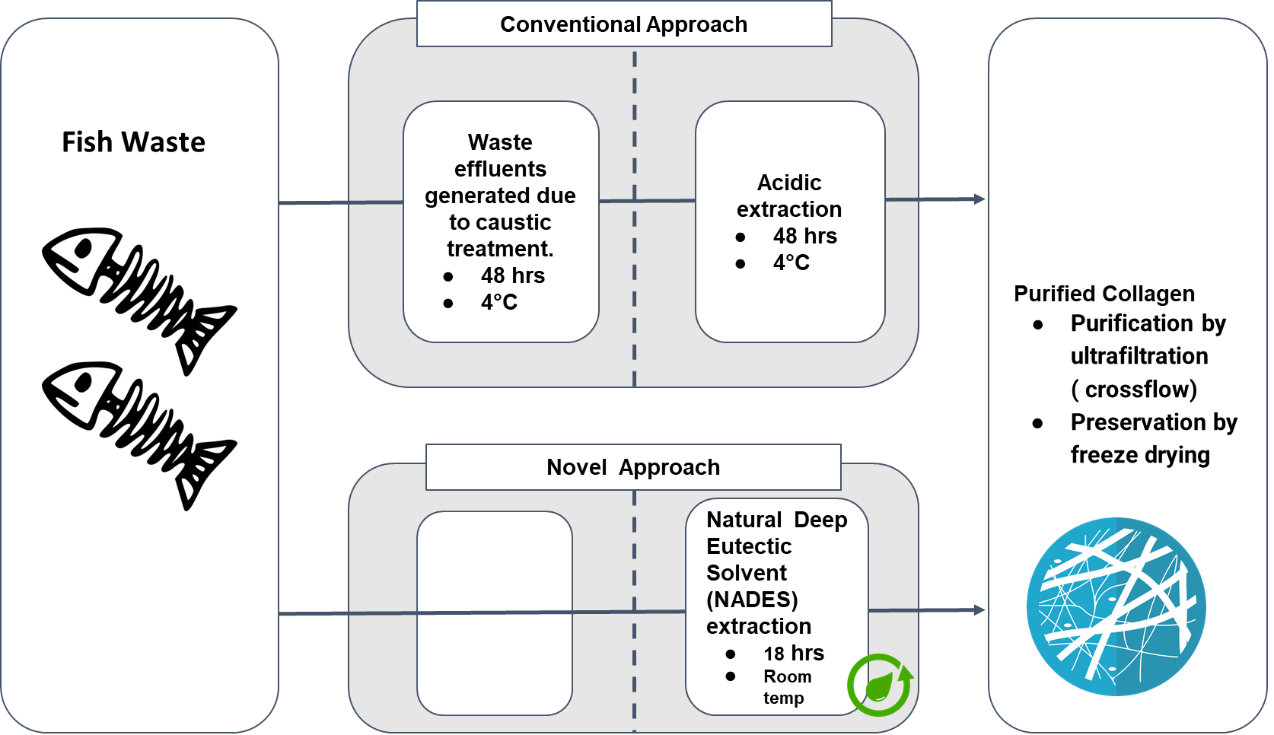
Industrial Biotechnology, Clean Energy & Environment
Transforming Fish Waste into Community Wealth: Collagen Extraction from Fish Waste
APPLICATION
Cosmetics: Collagen is utilized in skincare products for its anti aging and healing properties.
Food Industry: Collagen can enhance nutritional content in various food products.
Medical Sector: Collagen is used in wound healing, tissue engineering, and medical applications.
Agriculture: The biofertilizer derived from residue can improve soil fertility and crop growth.
Aquaculture: The fish feed derived from residue can improve nutrient absorption in fishes.
COMPANY NAME
TECHNOLOGY READINESS LEVEL (TRL)
INTELLECTUAL PROPERTY
Declutter Solutions Private Limited
TRL: 3
Application No: 202341085995
Title: Sustainable Collagen Extraction from Fish Waste Using Natural Deep Eutectic Solvents: A Zero Waste, Zero Liquid Discharge Approach with Biofertilizer and Fish Feed Production
Status: Provisional patent filed
FOUNDER’S NAME
Nitu Joseph, Sreechanth Sundaram
PROBLEM ADDRESSED
PRODUCT IMAGE
Large fraction of fish waste generated in India is not valorised resulting in pollution and stench due to open dumping
Fish collagen is currently extracted using acid and enzyme-based methods at low temperature- polluting and unsustainable
Alternative forms of collagen available are from bovine and porcine sources- potential to transmit zoonotic diseases
ABOUT THE TECHNOLOGY
USP
Disease-free
Waste to value
Sustainable
Circular economy
Biodegradable
Competitive cost
FUNDS RAISED/ACHIEVEMENTS
TANSEED 5.0- INR 15 Lakhs (funds pending disbursement)
Empower Her Journey Program by UNDP
END USERS / CUSTOMERS
Cosmetic industry
Nutraceutical Industry
Aquaculture
Agriculture
Incubated at PSG STEP
https://decluttersolutions.in/
tbi@kiitincubator.in

