Slide 1
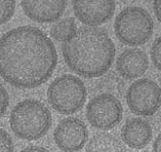
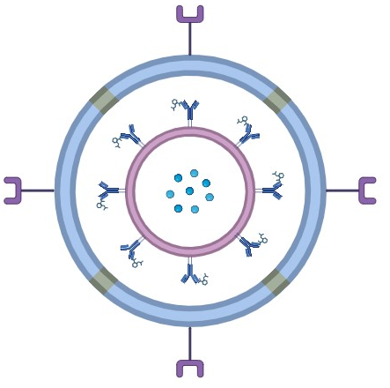
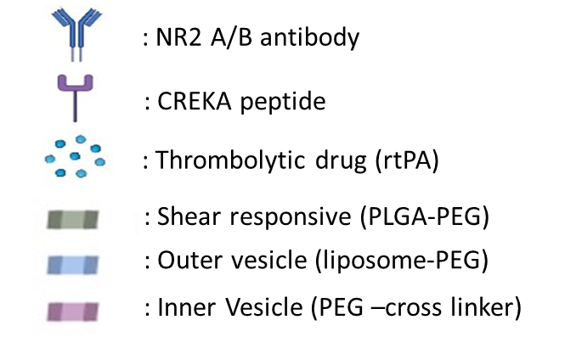
Insert Company Logo
Healthcare – Drug Delivery
Stroke-specific drug delivery for on-site treatment of the symptomatic patient
APPLICATION
Quick patient-site treatment for the stroke patient especially for the cases of ischemic stroke within the thrombolytic time window of 4 h 30 min
Specific identification of ischemic stroke by assessing unique signatures and biomarkers. Subsequently, releasing of the clot dissolving drug (rtPA) to the ischemic microenvironment
COMPANY NAME
TECHNOLOGY READINESS LEVEL (TRL)
INTELLECTUAL PROPERTY
Registering Soon
FOUNDER’S NAME
TRL: TRL-2 (Early Stage proof-of-concept
Give Patent details (App No, Title, Status)
Dr. Sujay Kumar Biswas,
Jishnu Mangalam,
Dr. Amit Haldar
PROBLEM ADDRESSED
PRODUCT IMAGE
Patient-site treatment for Stroke patient
Reduce time-delay in treatment for Ischemic stroke cases
Start treatment without brain imaging (MRI/CT Scan)
Reduce rtPA side-effect
PEG-rtPA
TEM image of the nanocomposite
ABOUT THE TECHNOLOGY
USP
Quick response in treatment for ischemic stroke patient
Reduce the chances of disability and mortality
Patient-site treatment with affordable drug nanocomposite
High potential for business development
Nanocomposite Drug
FUNDS RAISED/ACHIEVEMENTS
END USERS / CUSTOMERS
Awarded BIRAC BIG23 Grants for product development
Preparing for applying various other grants
Community Health Centre, rural dispensary
Stroke patient, pharmacy chains
Incubated at KIIT-TBI
CompanY Website link
tbi@kiitincubator.in

